Slide 1
PRINCIPLES OF PROGRAMMING LANGUGAGES
PROJECT 2
PREPARED BY
MUHAMMET ŞERAMET - 150115069
MAHMUT AKTAŞ - 150115010
ENGİN ZEYBEKOĞLU - 150116885
Notes:
Hello everyone. . This presentation is maded by me, Mahmut Aktaş and Engin Zeybekoğlu. Today we are gonna make a presentation on PHP programming language. So, lets get started.

Slide 2

History
PHP (PHP: Hypertext Preprocessor) is a scripting language that helps people make web pages more interactive by allowing them to do more intelligent, complex things.
PHP code is run on the web server.

Slide 3

History
PHP was first created by Rasmus Lerdorf in 1995.
Before creating PHP, Rasmus Lerdorf wrote several Common Gateway Interface in C to maintain his personal website
Originally, this script was written for tracking visitor for Rasmus’s resume on the internet and this system known as "Personal Home Page Tool" in short "PHP Tool".
Notes:
PHP was released in 1995 and writed in C. It was originally stood for Personal Home Page, a tool created for tracking visits to Rasmus’s online resume and monitor traffic. But it now stands for PHP: Hypertext Preprocessor.

Slide 4
What Is PHP Used For?
PHP is a powerful tool for making dynamic and interactive web pages
That’s why PHP generally runs on a web server
Notes:
There are three main areas where PHP scripts are used.
1 - Server-side scripting. You need three things to make this work: the PHP parser (CGI or server module), a web server and a web browser. You need to run the web server, with a connected PHP installation. This is the most traditional and main target field for PHP.
2- Command line scripting. You can make a PHP script to run it without any server or browser. You only need the PHP parser to use it this way. These scripts can also be used for simple text processing tasks.
3 - Writing desktop applications. PHP is probably not the very best language to create a desktop application with a graphical user interface, but if you know PHP very well, and would like to use some advanced PHP features in your client-side applications you can also use PHP-GTK to write such programs.

Slide 5
What Is PHP Used For?
With PHP, we can develop web-based applications, eCommerce applications etc
PHP also used for web content managment systems.
PHP offers support to numerous databases including MySQL, Oracle and MS Access

Slide 6
Why Choose PHP
PHP is fast and simple
It is an open source language with a great community support
It is portable for all operating systems
Notes:
PHP also has support for most of the web servers today. This includes Apache, Internet Information Services(IIS), and many others.

Slide 7
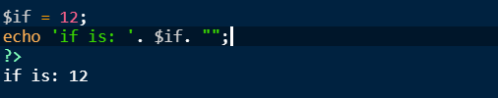
Properties of PHP
In PHP, variables are case sensetive. So if we define a variable named $name = ‘some name’ and try to call this variable with $Name, we’ll get an error.
Despite of the case sensitiveness of variables, all keywords (e.g. if, else, while, etc.), classes, functions, and user-defined functions are NOT case-sensitive.
PHP has no reserved words. All special words are keywords. So they can be used as identifiers

Slide 8
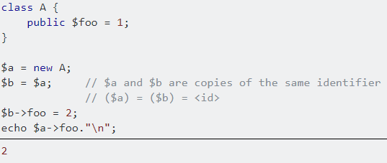
Properties of PHP
A PHP reference is an alias, which allows two different variables to write to the same value.

Slide 9
Properties of PHP
PHP supports string, integer, float, boolean, array, object, NULL and resource data types defaultly.
String, integer, float and booelan types are implicitly defined when a variable is created
For example if we declare a variable such as ‘$txt = "Hello world!";’, PHP defines this variable as a string.
So we can say that PHP is dynamic typed language. Type binds occurs at runtime.

Slide 10
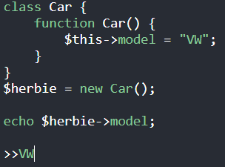
Properties of PHP
To define arrays there is a keyword named ‘array’
$cars = array("Volvo","BMW","Toyota");
Since PHP is an OOP language, objects are defined by using ‘class’ keyword

Slide 11
Properties of PHP
PHP variables are stored implicit heap-dynamic. So variable types defined at runtime
Different from the other languages, PHP has function scope
Only the variables declared in that function and function parameters can be called inside a function
Variables declared outside of the functions cannot be called inside the functions and vice versa

Slide 12
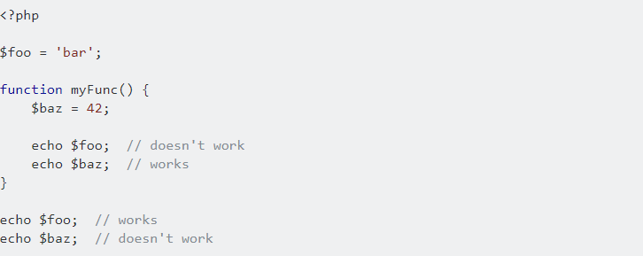
Properties of PHP

Slide 13
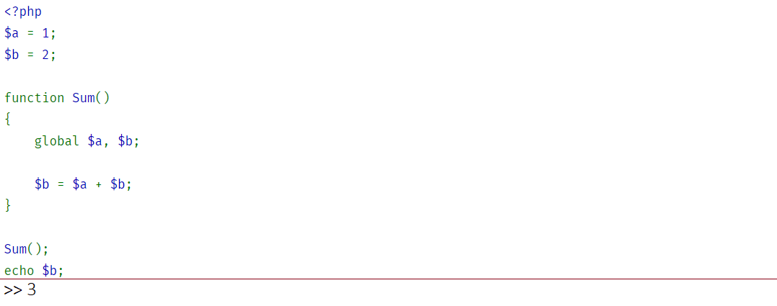
Properties of PHP
But still PHP allows global variables
In order to access global variables inside a function, we need to redeclare global variables inside the function

Slide 14
Properties of PHP
PHP supports total eight primitive data types:
Integer
Float
String
Booleans
Array
Object
resource
NULL

Slide 15
Properties of PHP
Since PHP does not have explicit declaration of data types, strings have dynamic length
Enumeration is not a primitive data type for PHP

Slide 16
Properties of PHP Arrays
PHP supports integer, string are legal for array subscripts
Array subscript ranges are dynamic, so there is no subscript range checking
Binding of subscript ranges and storage allocation is dynamic and can change any number of times, thus arrays can grow or shrink during execution
Array alloction is done in runtime because PHP variables stored as impilict heap-dynamic
Notes:
PHP supports integers and strings as legal array subscript type

Slide 17
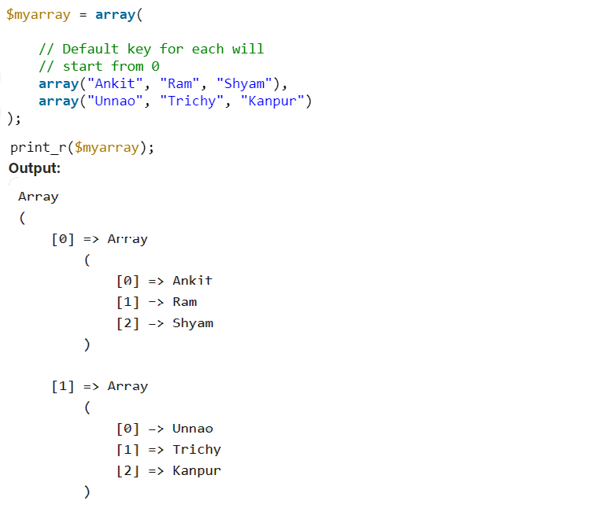
Properties of PHP Arrays
PHP supports jagged and multidimensional arrays
Notes:
So we can create arrays inside an array. Here is an example for that. Each array is an element of the outer array.

Slide 18
Properties of PHP Arrays
Arrays can be sliced by using array_slice() method
This method can take 4 parameters.
array: array to be sliced. It is required
start: specifies where the function will start the slice. It is required
length: specifies where the function will stop slicing. It is optional
preserve: specifies if the function should preserve or reset the keys. It is boolean and optional

Slide 19
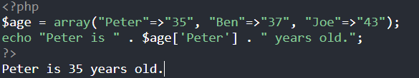
Properties of PHP Arrays
PHP supports associative arrays
Notes:
So we can assign keys fır array elements

Slide 20
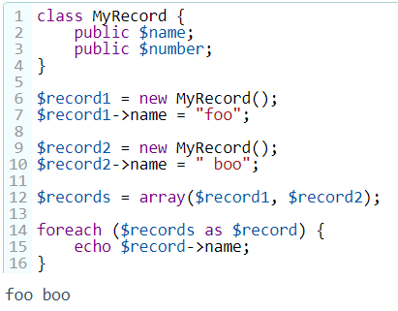
Properties of PHP
PHP does not have a keyword for record type but we can implement records by creating classes
Notes:
In this example we have a class named record. We can use each instance of this class as a record. Then we can create an array to hold each record and print them.

Slide 21
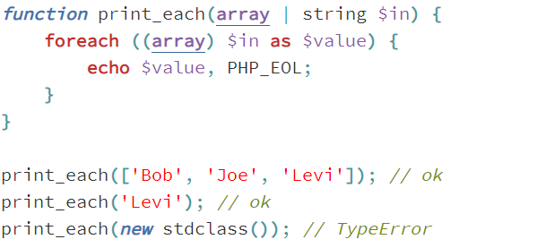
Properties of PHP
PHP does not support tuples
PHP supports union of types such as:
Notes:
this example. So we can create a function and this function can take two types of parameter, array and string. If we try to give another type, PHP will give the type error.

Slide 22
Properties of PHP
PHP does not support pointer

Slide 23
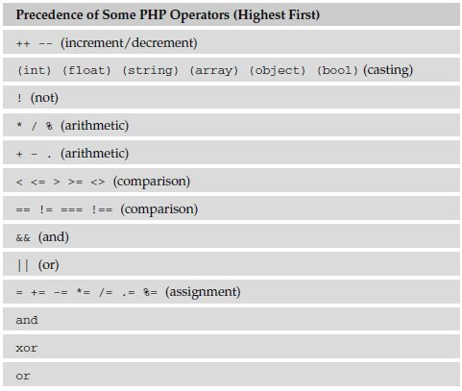
Properties of PHP Arithmetic Expressions
Here is the operator predecedence list of PHP
PHP starts to evalute from left to right for same level operators since it has a left-to-right associativity

Slide 24
Properties of PHP Arithmetic Expressions
So for example; ++x * 2 / 5 is calculated in these steps:
First evaluate the increment operation.
Then, calculate the multiply operation because of the left-to-right associativity
After that, divide the expression by 5.

Slide 25
Properties of PHP Arithmetic Expressions
Operator precedence and associativity only determine how expressions are grouped, they do not specify an order of evaluation
PHP does not generally specify in which order an expression is evaluated and code that assumes a specific order of evaluation should be avoided, because the behavior can change between versions of PHP or depending on the surrounding code.
The expressions on the right side of the || operator might call functions that perform substantial or important work, or have side effects.

Slide 26
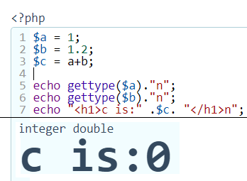
Properties of PHP Arithmetic Expressions
PHP does not support operator overloading
PHP also does not support mixed type operations
Notes:
So in this example we have two variables. One of them is integer and the other is double. When we try to add them, PHP will give the result zero since it does not support mixed type operations.

Slide 27
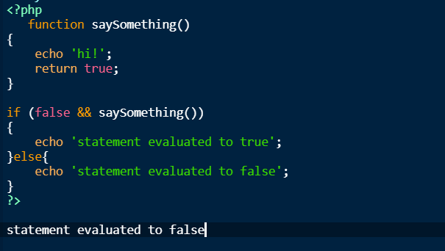
Properties of PHP Arithmetic Expressions
PHP compiler uses short-circuit evaluation. Here is an example
Notes:
So in this example, we create a function and try to call this function inside an if statement. If the first logilcal operator is false and the operation is an and operation, PHP does not evaluate the function and immediately goes to else part.

Slide 28
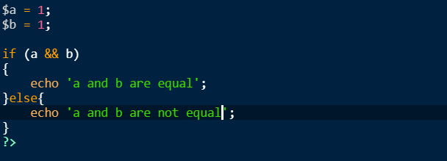
Properties of PHP Statement Level Control Structures
Control expressions in PHP have this form:

Slide 29
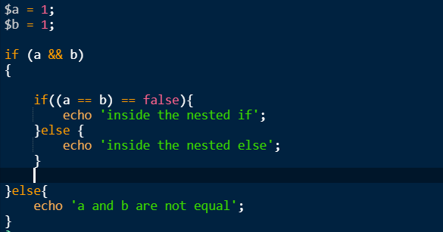
Properties of PHP Statement Level Control Structures
Nested control expressions are like this:

Slide 30
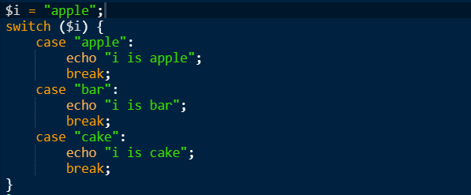
Properties of PHP Statement Level Control Structures
PHP has a switch statement for multiple control expressions

Slide 31
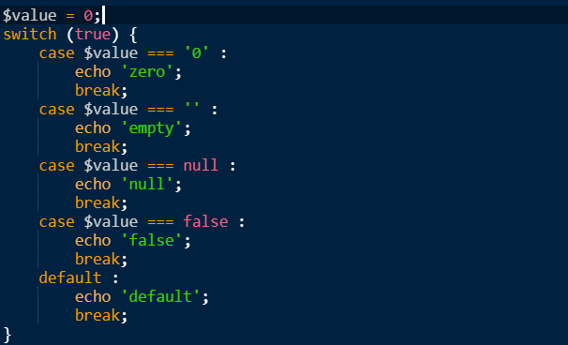
Properties of PHP Statement Level Control Structures
Case values can be integer, double, boolean or string
Selectable segments can be statements also
Unrepresented expression handled with the default keyword

Slide 32
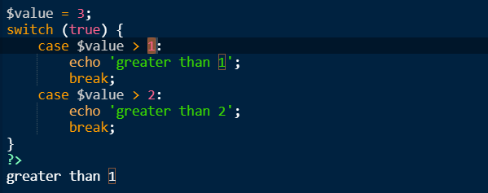
Properties of PHP Statement Level Control Structures
In PHP’s switch statements, the execution of the flow is restricted to only one case. So if two of the cases true for the control statement first case will be used

Slide 33
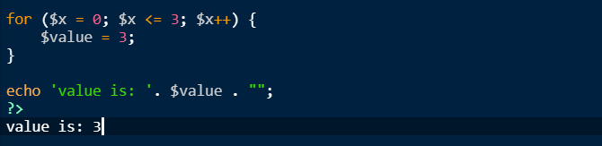
Properties of PHP Statement Level Control Structures
In PHP loops, the variables defined in a loop statement are accessable outside of the loop

Slide 34
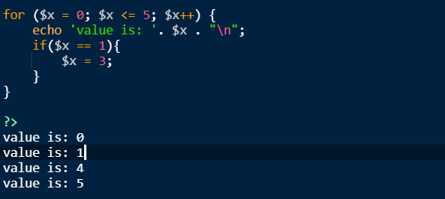
Properties of PHP Statement Level Control Structures
In PHP, changing the loop variables are allowed. So if we change a control variable, loop continues or stops depending on the changed value

Slide 35
Properties of PHP Statement Level Control Structures
Loop parameters evalution times are given:
for (init; condition; update)
init: start value, can be int, char etc. (works once)
condition: check condition (works at the beginning of each iteration)
update: update the init value,(works after end of each iteretion)
while(condition) //iterates on true
condition: check condition (works at the beginning of each iteration)

Slide 36
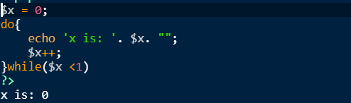
Properties of PHP Statement Level Control Structures
Logically controlled loops of PHP are a special case of count controlled loops
For logically controlled loops, PHP have both pretest and posttest forms, since it has for and while loops for pretest and do-while loop for posttest
Here is a posttest example:

Slide 37
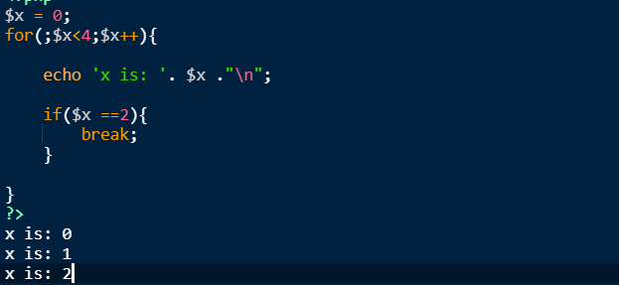
Properties of PHP Statement Level Control Structures
PHP loops also supports user-located control mechanism
One of the user-located control mechanism provided by break statement

Slide 38
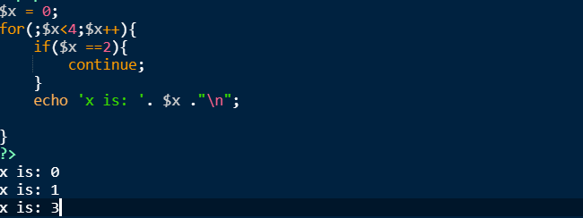
Properties of PHP Statement Level Control Structures
The other user-located mechanism is continue statement

Slide 39
Properties of PHP Statement Level Control Structures
PHP supports iteration based on data structures
current() - Return the current element in an array
end() - Set the internal pointer of an array to its last element
next() - Advance the internal pointer of an array
prev() - Rewind the internal array pointer
reset() - Set the internal pointer of an array to its first element

Slide 40
Properties of PHP Statement Level Control Structures
Here is an example of iteration based on data structures:
$element = array('first', 'second', 'third', 'fourth', 'fifth');
$selected = current($element ); // $selected = 'first';
$selected = next($element ); // $selected = 'second';
$selected = current($element ); // $selected = 'second';
$selected = prev($element ); // $selected = 'first';
$selected = end($element ); // $selected = 'fifth';
$selected = current($element ); // $selected = 'fifth';
$selected = reset($element ); // $selected = 'first';

Slide 41
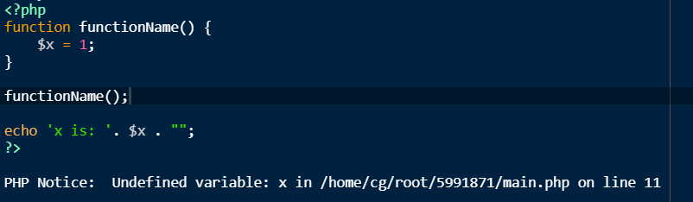
Properties of PHP Subprograms
In PHP, local variables are dynamicly allocated
As an example for this after execution of a function, all the local variables are removed.

Slide 42
Properties of PHP Subprograms
In PHP, provided passing parameters are defaultly pass-by-value and for the pass-by-reference add '&' at the beginning of the variable foo(&$a) or pass an object
Also types of the actual parameters checked against the types of the formal parameters in PHP version 7

Slide 43
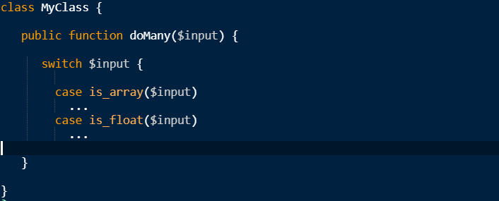
Properties of PHP Subprograms
All supported types can be returned from a function
Only one value can be returned. Multiple values can be returned inside an array
PHP does not natively support method overloading. It can be achieved with several ways.
One of them is type checking inside the method with switch cases

Slide 44
THANK YOU FOR YOUR TIME!

